Slide 1

INTRODUCTION TO PACKET TRACER AND BASIC CONFIGURATIONS
NOVEMBER 2024

Slide 2

WHAT IS PACKET TRACER?
Packet tracer is an application in which students use simulated environments to create, configure, implement and troubleshoot network topologies.

Slide 3
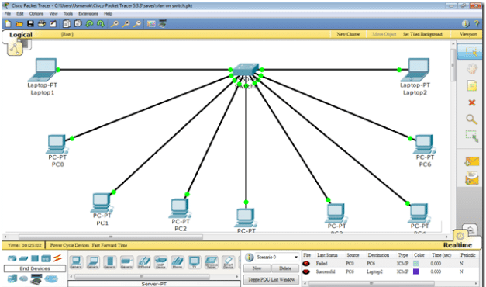
PARTS OF THE PACKET TRACER SCREEN
1.Menu bar
2.Main tool bar
3.Common tools bar
4.Logical/Physical workspace and navigation bar
5.Workspace
6.Realtime/Simulation bar
7.Network component box
8.Device type selection
9.Device-specific selection
10.Packet window

Slide 4
DEVICE SELECTION AND CONNECTION
Choose device from device type selection and then click on any area within the workspace.
Click connections icon from the device type selection and click the appropriate cable type which is connected between the devices by clicking on both of them in succession.

Slide 5

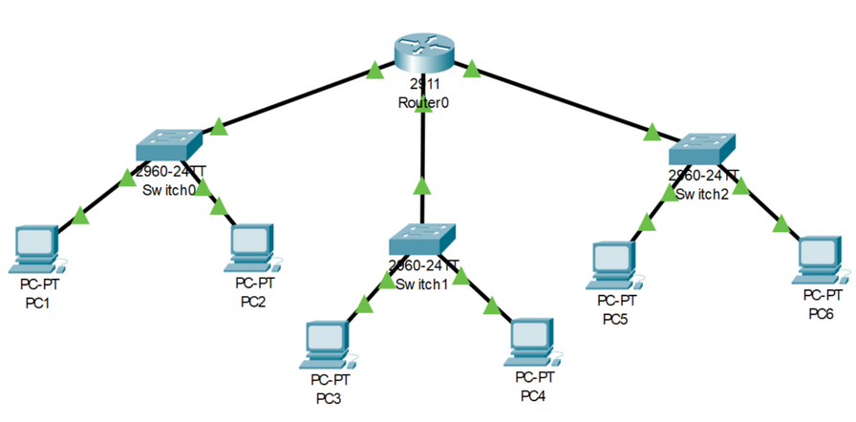
01
Accessing the command line interface
STEPS FOR BASIC ROUTER CONFIGURATION
Double click on the router in the packet tracer environment.
02
Entering the privileged EXEC Mode
Type enter and press enter. It is not necessary to set a password.
03
Entering Global Configuration Mode
Type the configure terminal command or type config t (click tab key for this one) and press enter.
At this stage you can carry out interface configuration i.e.: interface FastEthernet0/0-> Ip Address 192.168.1.1 255.255.255.0->no shutdown.
You can also set routing protocols and static routes in this mode.
04
Saving the configuration
Type exit to leave the global configuration mode and type write memory to save the configuration.
NB: A command known as show commands to verify your configurations and troubleshoot issues.

